Slide 1
PHP & Oracle database
Using OCI8 Driver

Slide 2

PHP & Oracle database
JAVA data generator
PHP application

Slide 3
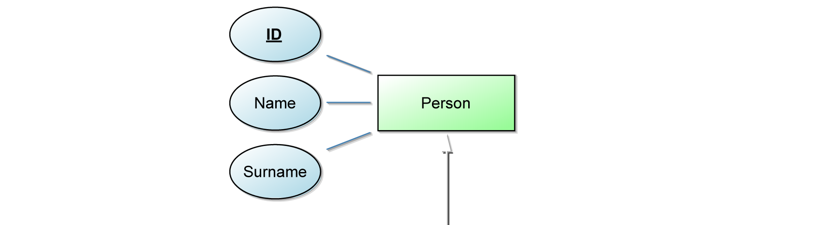
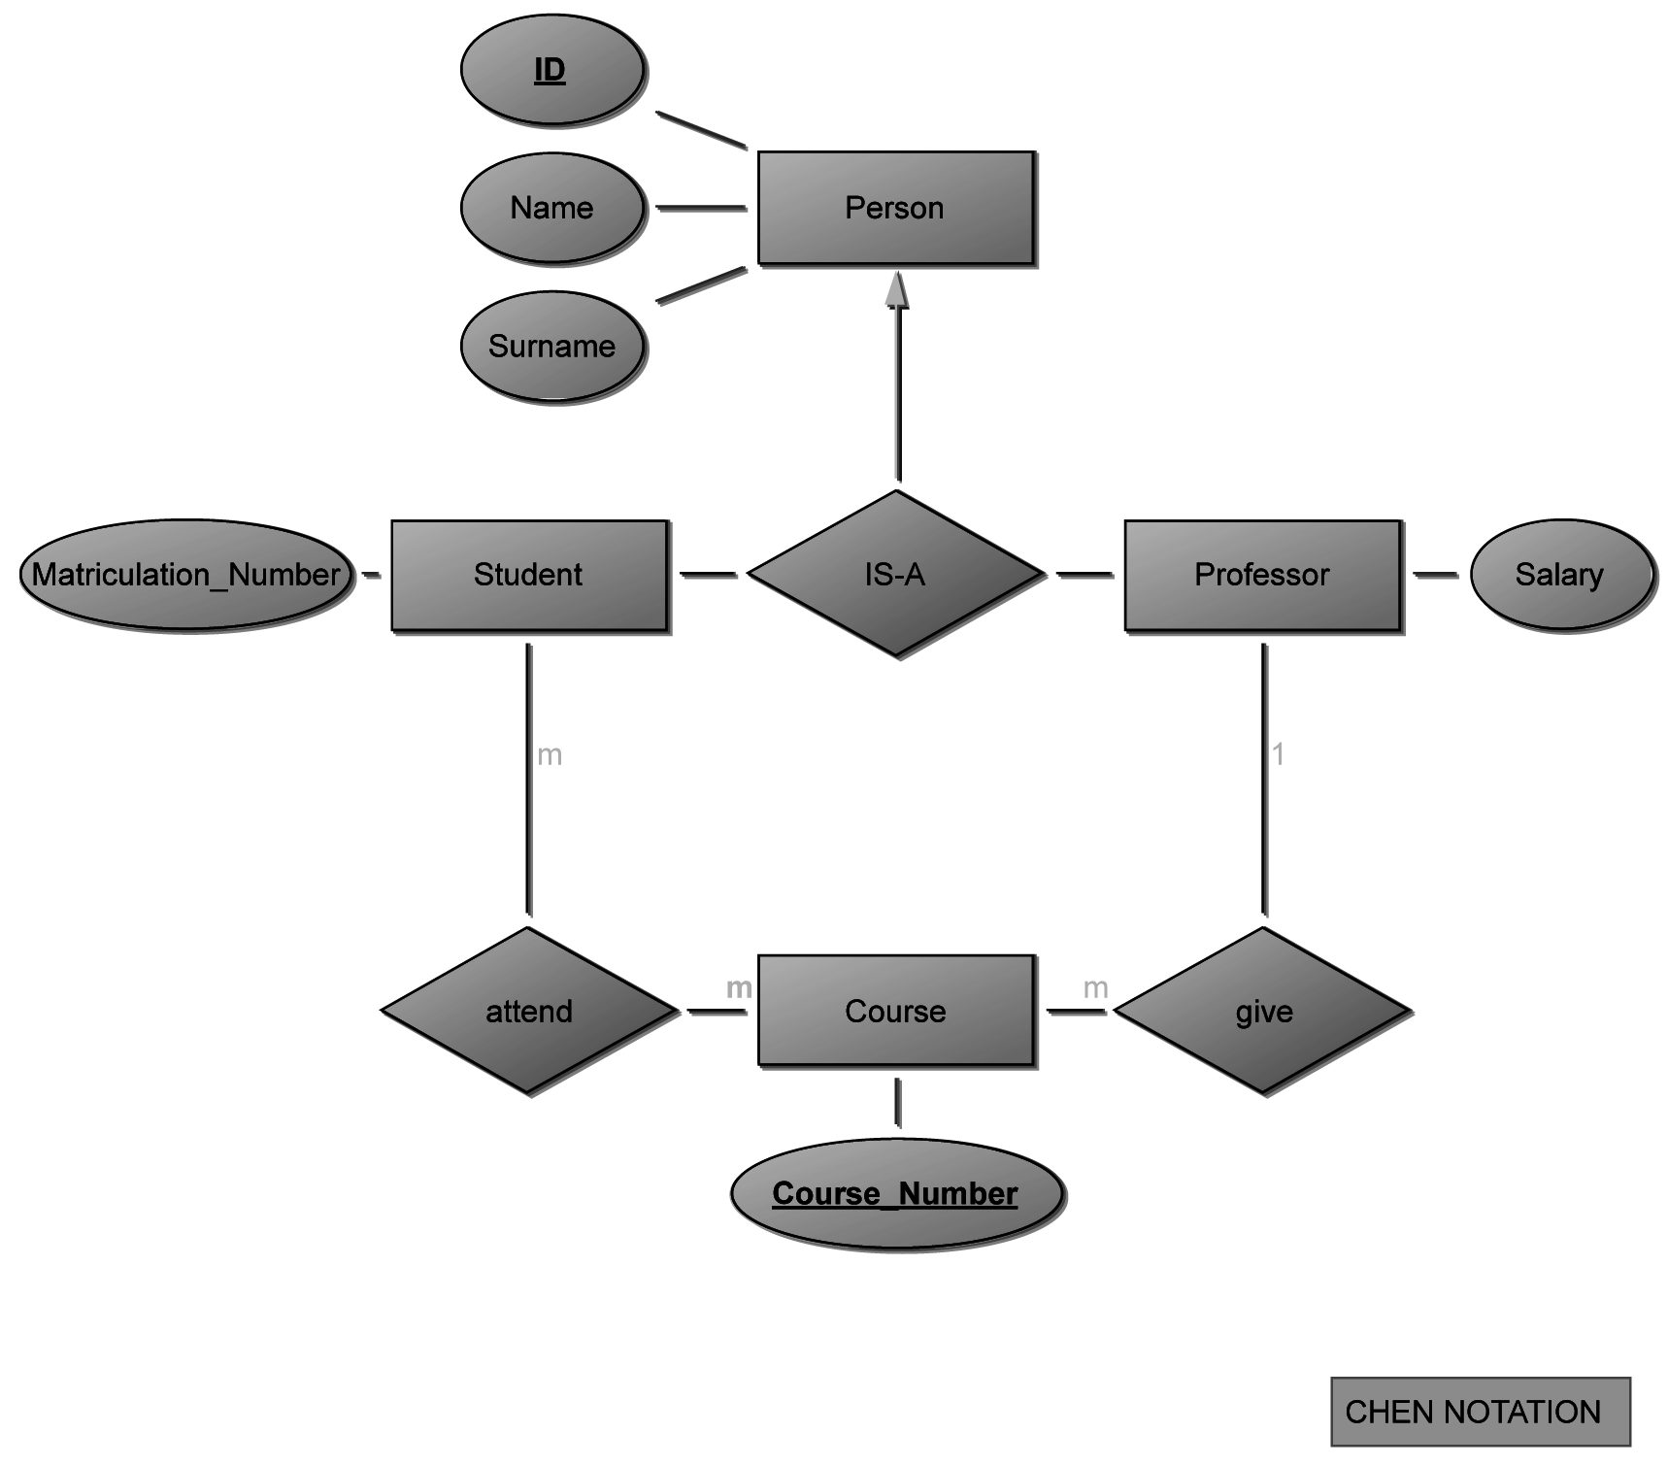
ER Model

Slide 4
SQL 1/2
CREATE TABLE person ( person_id INTEGER NOT NULL, name VARCHAR(20) NOT NULL, surname VARCHAR(20) NOT NULL, CONSTRAINT pk_per_pid PRIMARY KEY (person_id) );
CREATE SEQUENCE seq_person_pid START WITH 1 MINVALUE 1 INCREMENT BY 1 CACHE 100; CREATE OR REPLACE TRIGGER tri_person_pid BEFORE INSERT ON person FOR EACH ROW BEGIN SELECT seq_person_pid.nextval INTO :new.person_id FROM dual; END;

Slide 5
SQL 2/2
CREATE PROCEDURE p_delete_person( p_person_id IN person.person_id%TYPE, p_error_code OUT NUMBER ) AS BEGIN DELETE FROM person WHERE p_person_id = person.person_id; p_error_code := SQL%ROWCOUNT; IF (p_error_code = 1) THEN COMMIT; ELSE ROLLBACK; END IF; EXCEPTION WHEN OTHERS THEN p_error_code := SQLCODE; END p_delete_person; /
p_error_code = 1
> OK
p_error_code = 0
> id not existing
p_error_code = else
> other db error
Not relevant for the tutorial!
Create and commit the commands

Slide 6
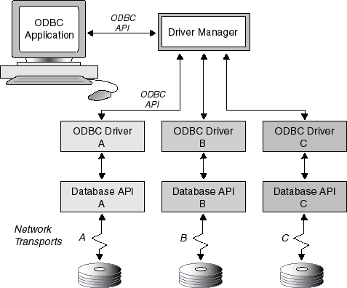
ODBC Driver
Open Database Connectivity (ODBC)
allows to access Database management systems
provides a standard interface for accessing databases
“The model begins with an ODBC application making a call to the Driver Manager through the ODBC application program interface (API). The Driver Manager can be either the Microsoft Driver Manager or the unixODBC Driver Manager. Still using the ODBC API, the Driver Manager makes a call to the ODBC Driver. The ODBC Driver accesses the database over a network communications link using the database API. “
https://docs.oracle.com/database/121/ADFNS/adfns_odbc.htm?ref=binfind.com/web

Slide 7
Brief overview of PHP App design
index.php
Starting point of app
Contains all forms
Contains table with persons
DatabaseHelper.php
Contains PHP class
Encapsulates communication with database
Provides methods for SELECT, INSERT, DELETE, …

Slide 8
DB connection with PHP
Create connection
$this->conn = @oci_connect(
username,
password,
con_string
);
Run a statement
$statement = @oci_parse($this->conn, $sql);
$success = @oci_execute($statement) && @oci_commit($this->conn);
@oci_free_statement($statement);

Slide 9
DB connection with PHP
Run a Query statement
$statement = @oci_parse($this->conn, $sql);
@oci_execute($statement); @oci_fetch_all($statement, $res, 0, 0, OCI_FETCHSTATEMENT_BY_ROW);
@oci_free_statement($statement);
<?php foreach ($person_array as $res) : ?>
<tr>
<td><?php echo $person['PERSON_ID']; ?> </td>
<td><?php echo $person['NAME']; ?> </td>
<td><?php echo $person['SURNAME']; ?> </td>
</tr>
<?php endforeach; ?>

Slide 10
DB connection with PHP
Extend the index.php and the DatabaseHelper.php: Add function which automatically adds the Person „Ann Smith“ if index.php is loaded
public function insertAnnSmith()
{
//your code
}

Slide 11
DB connection with PHP
Extend the DatabaseHelper.php: Add function which returns all Persons with the name „Ann Smith“ ´- add them to the index.php
public function getAnnSmiths()
{
//your code
}

Slide 12
Use Bootstrap
Download a Bootstrap template and integrate your application
Create a form for inserting, listing and deleting persons
Example:
http://demo.themewagon.com/preview/free-bootstrap-admin-dashboard-template-majestic-admin

Slide 13
Points of Extension
Call Stored Procedure
Javascript
Class-based design

